Slide 1
Let’s start coding
Recitation 3

Slide 2
Agenda
Read the homework write up carefully and follow instructions.
Grading will be done on cloud 9, so all your files have to compile and run on cloud 9.
Mark your attendance every recitation:
Using the password provided at the end.
Cannot find your name? Let me know and I’ll add it manually.

Slide 3
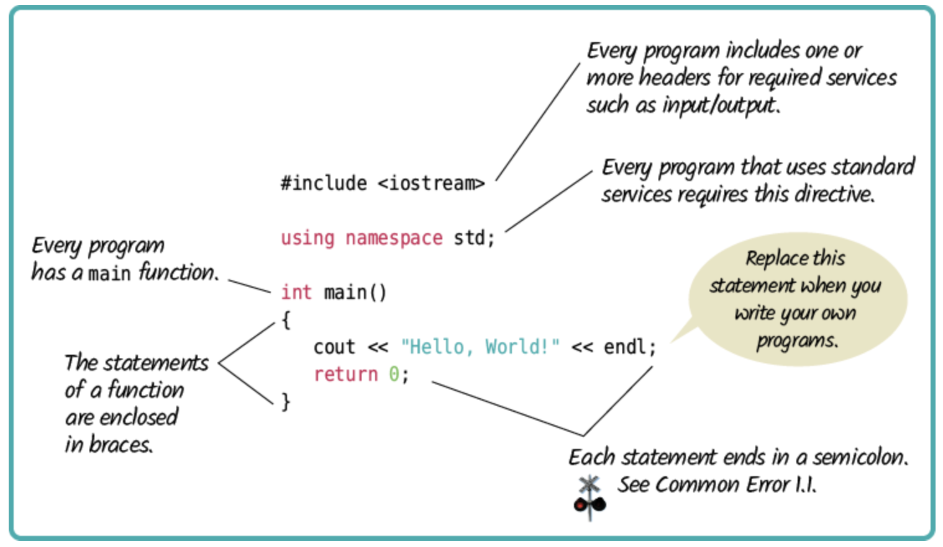
Hello, World!

Slide 4
Libraries and Namespace
Library: A library is a collection of code that you can use.
iostream is a library that provides you with functionality to handle inputs and outputs.
Can be already present or defined by us.
Namespace: It is used to avoid naming clashes.
std is a standard namespace which has cin and cout defined.

Slide 5

cin and cout

Slide 6
cin and cout
Basically pipes connection program to the terminal window.
‘cin’ is a standard input stream. Used to transport user data as input to the program.
’cout’ is a standard output stream. Used to transport program output to the terminal.

Slide 7
Data Types
int (integers)
int age = 10;
char (characters)
char myChar = ‘c’;
float (floating-point numbers) 7 digits
float myFloat = 4.45319;
double (double precision floating-point numbers) 15 digits
double myDouble = 4.45314531245312;
string (sequence of characters)
string name = “Abhilash”

Slide 8
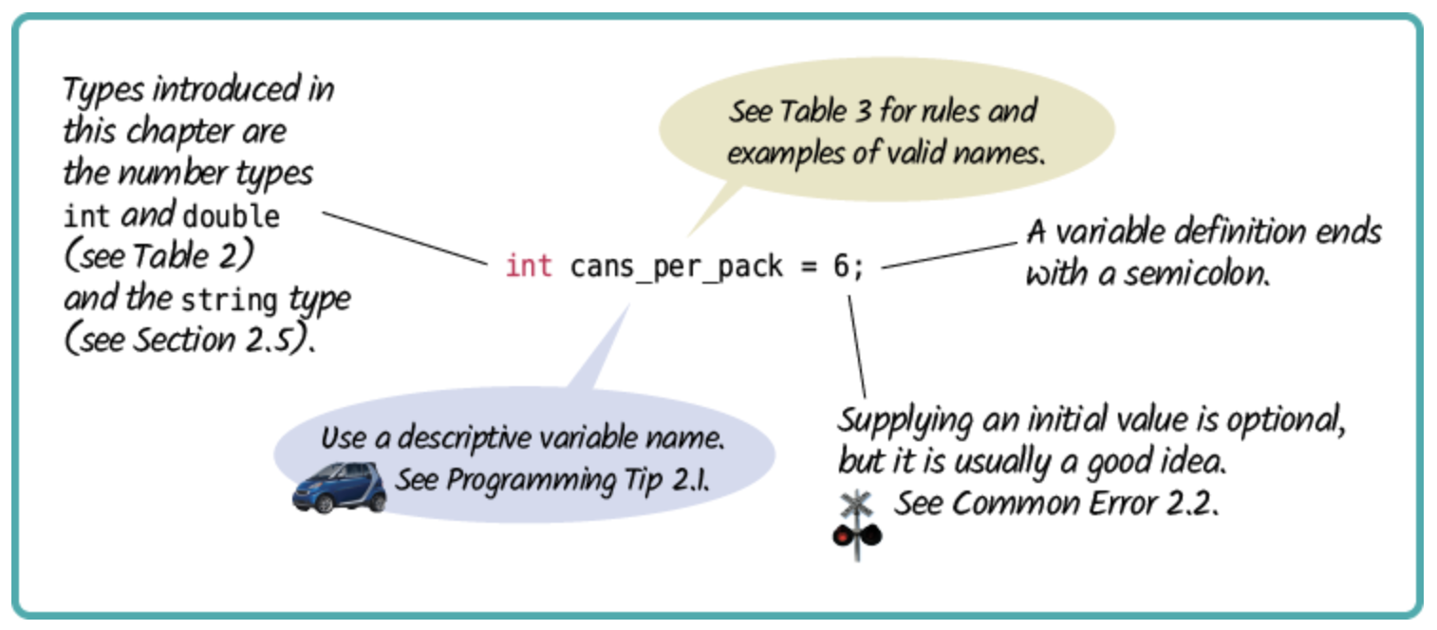
Declaration

Slide 9
Moodle CodeRunner Submission Demo

Slide 10
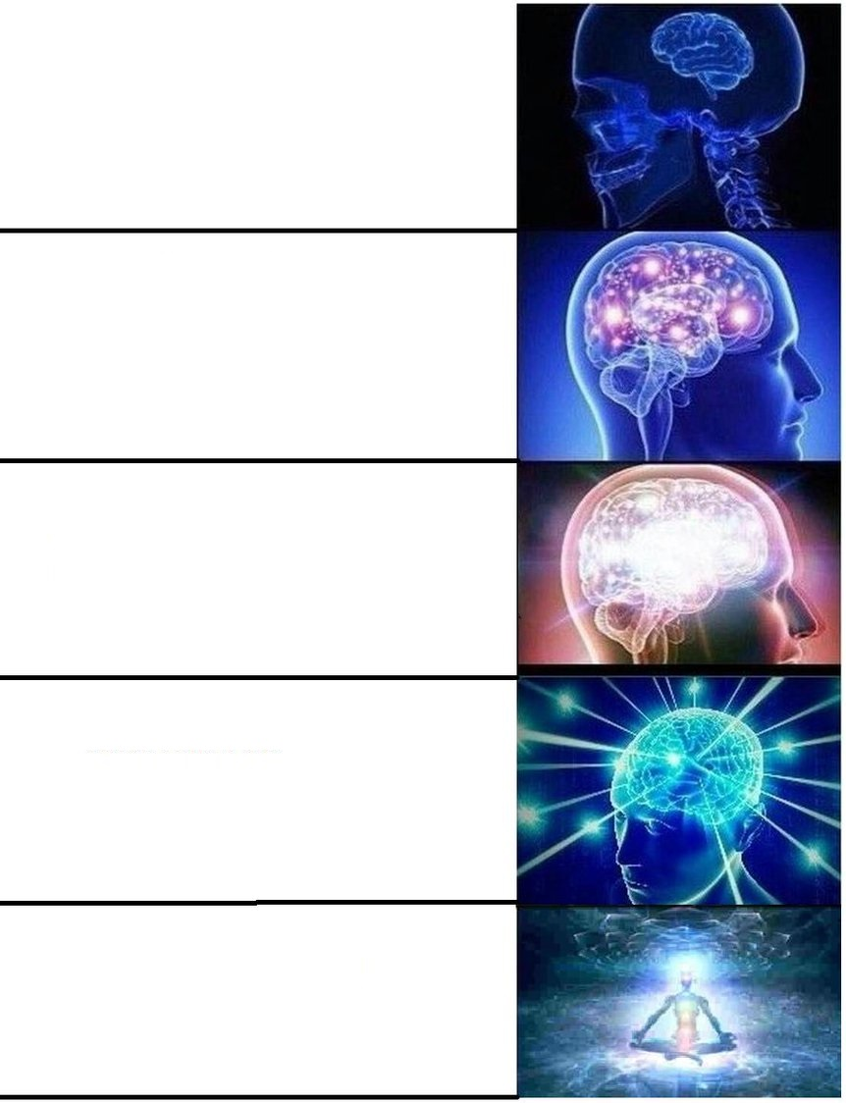
Homework Tips
Doing most of the homework
Comments
Follow style guide
Submit before Friday at 11:59pm = 5% EXTRA CREDIT
Doing all the homework
Doing all the homework correctly
Doing all the homework correctly and with good comments!
Submitting your perfect homework early!!

Slide 11
Homework Time!

